Slide 1
Deciphering the Strategies and Formulas Behind League of Legends Professional Play
Murphy Li

Slide 2
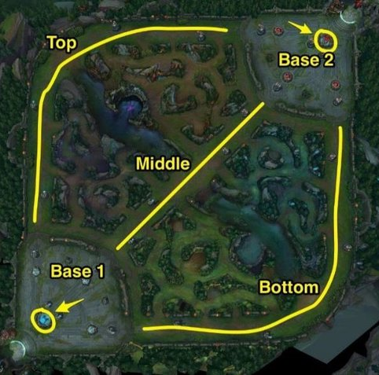
Online 5v5 Moba game
Top, mid: Lanes where players 1v1
Bottom: 2v2 lane each with an adc and support
Jungle: roams between all three lanes, clearing jungle camps, aiding laners and securing neutral objectives
Objective of the game: destroy towers and inhibitors to open enemy base to destroy enemy nexus
11 towers in total for each side: 2 towers in each lane, 1 inhibitor in each lane, 1 tower defending each inhibitor, 2 towers defending nexus
Base 1: Blue side
Base 2: Red side

Slide 3
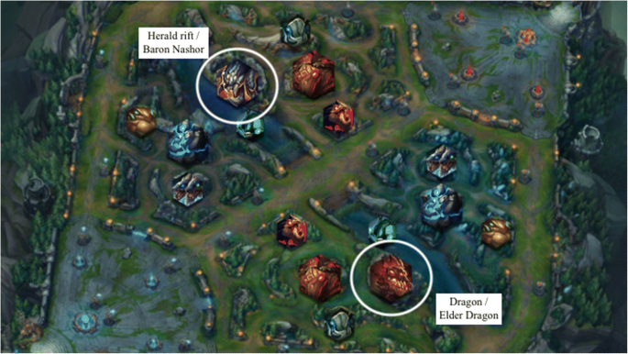
Neutral objectives
Top side:
Void grubs
Herald
Baron
Bot side:
Dragon
Elder Dragon

Slide 4
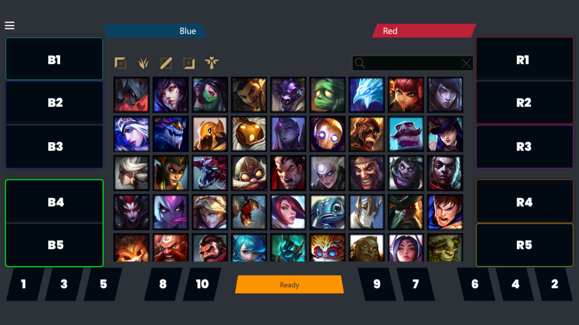
Draft Phase
5 Picks and bans per side
Order
Bans 1-6
B1
R1, R2
B2, B3
R3
Bans 7-10
R4
B4, B5
R5

Slide 5
Research Questions
How accurately can the outcome of games be predicted using early game data compared to late game data?
How does the presence or absence of key in-game objectives (e.g., Barons, Dragons) impact the final result of a match?
Does the composition of champions selected during the draft phase significantly influence the likelihood of winning a game?

Slide 6
Data
2014 – 2024 (Season 3 to Season 13)
All professional matches worldwide
Over 40 leagues (regions) of Tier 1 and tier 2 competitions
Source: oracleselixir, League of Legends esports data base

Slide 7
Theoretical Framework DAG
Draft
(Champion pick, bans)
In-game Metrics
Result
Team/ player skill

Slide 8
In-game Variables (1)
Barons: Number of barons captured
Dragons: Number of dragons captured
Firstbaron: Binary variable indicating whether the team captured first baron
Firstherald: Binary variable indicating whether the team captured first herald
Firstmidtower: Binary variable indicating whether the team destroyed first mid tower
Firsttothreetowers: Binary variable indicating whether the team was the first to destroy three towers
Gamelengthinm: Game length in minutes
Golddiffat15: gold difference at 15 minutes

Slide 9
In-game Variables (2)
Goldspentdiff: Difference in gold spent at the end of the game
Heralds: Number of heralds captured
Inhibitors: Number of inhibitors destroyed
Percent_total_kpm: Team kills per minute divided by total champion kills per minute (kill share)
Result: Binary variable indicating whether the team won the game
Towers: Number of towers destroyed
Void_grubs: Number of void grubs captured
Wpm: Wards per minute

Slide 10
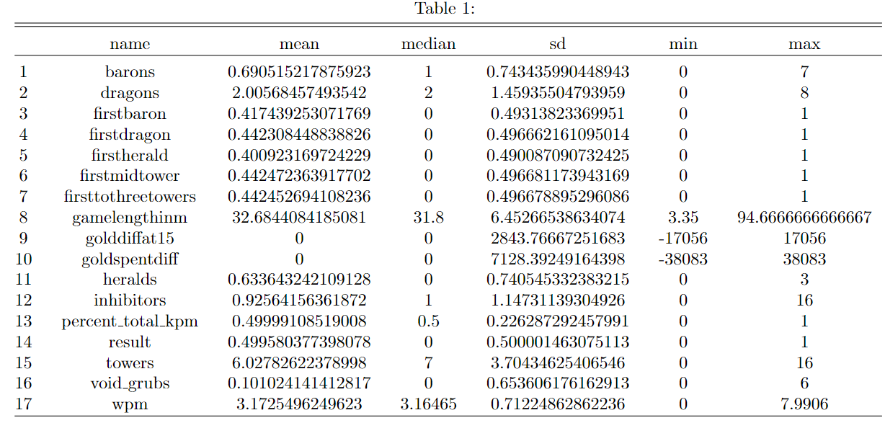
Summary statistics
Notes:
Variables 3 to 7 and 14 are binary variables where as the remainder are numerical variables , game length in minutes have a small standard deviation but a large range indicating the possibility of out liers.

Slide 11

Exploratory Data Analysis

Slide 12
Conditional probabilities
Win rate given a positive gold lead at 10 minutes: 69.2%
Win rate given a positive gold lead at 15 minutes: 74.4%
Win rate given a positive experience lead at 10 minutes: 66.6%
Win rate given a positive experience lead at 15 minutes: 71.9%
Win rate given First dragon captured: 61%
Win rate given First baron captured: 85.1%
Win rate given First herald captured: 60.3%
Notes:
Conditional probabilities showing the probability of winning a game conditional on a number of early game accomplishments and leads, most notable is teams securing first baron having a win rate of 85.1% while others are significantly lower at around 68%

Slide 13
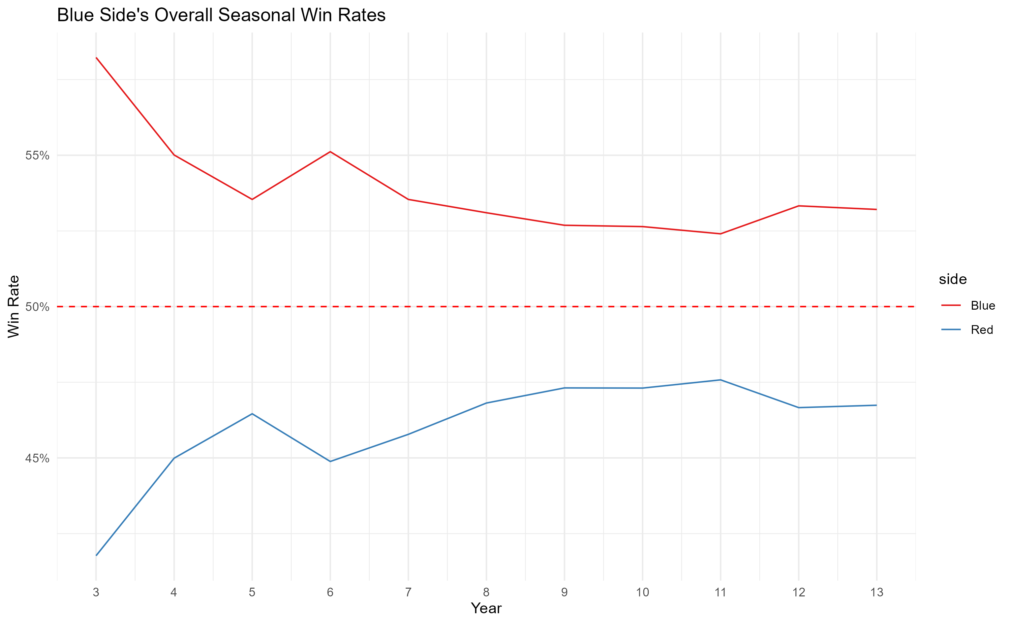
Notes:
Blue side has consistently shown a slight advantage since season 3

Slide 14
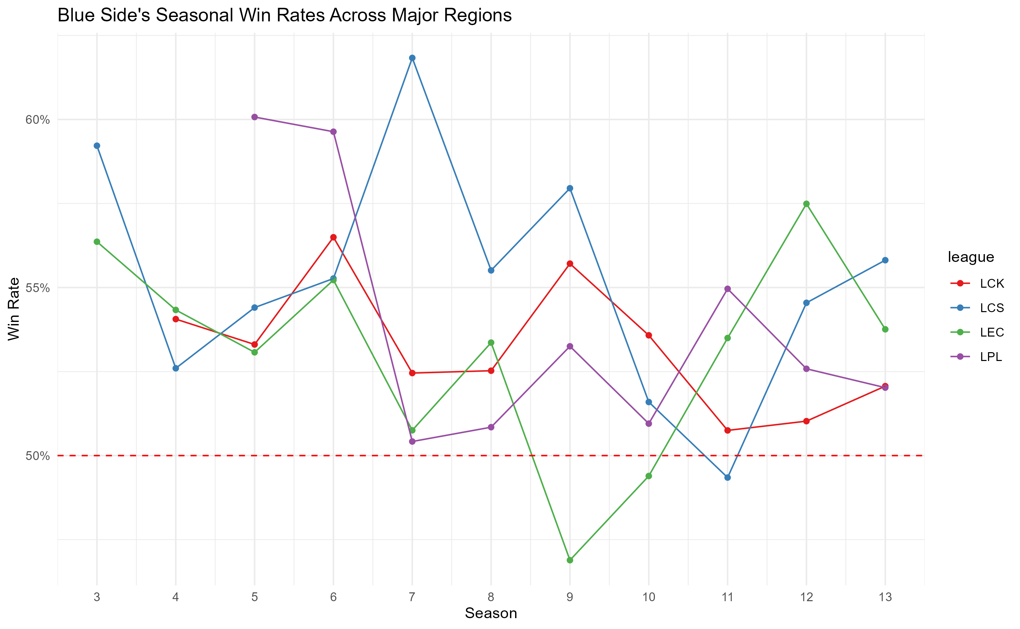
Notes:
Looking at world class leagues, a slight blue side advantage still exists, with LEC occasionally dropping below a 50% win rate in seasons 9 and 10

Slide 15
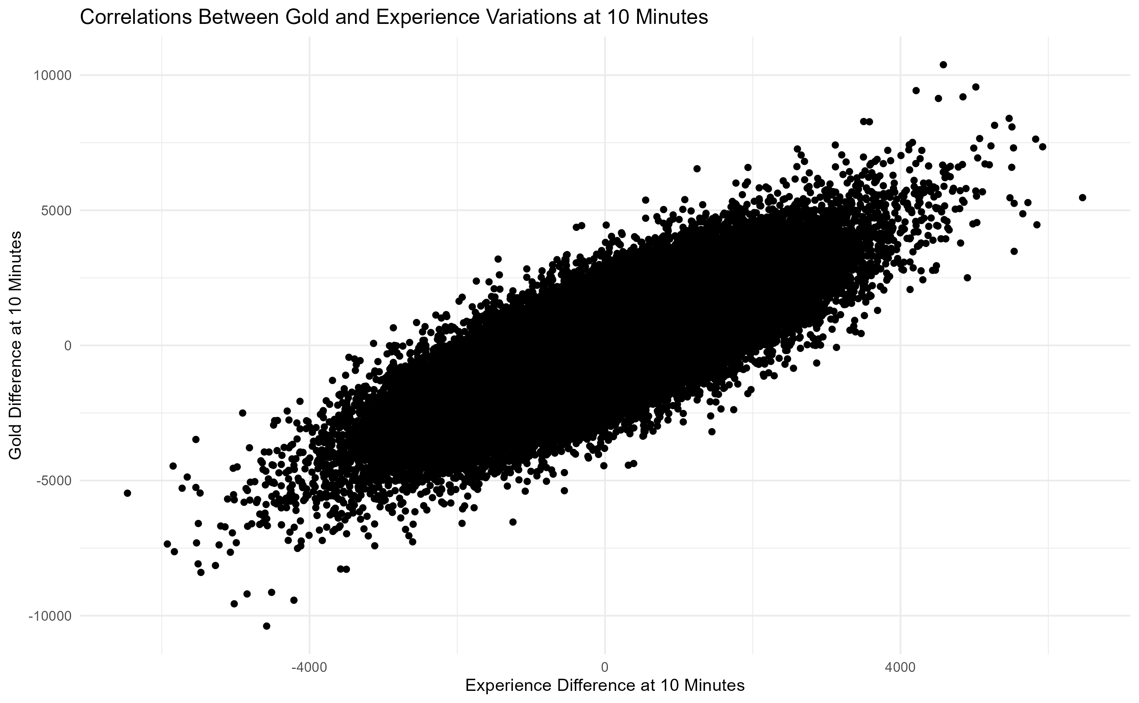
Notes:
Strong correlation between the two variables, suggest multicolinearity

Slide 16
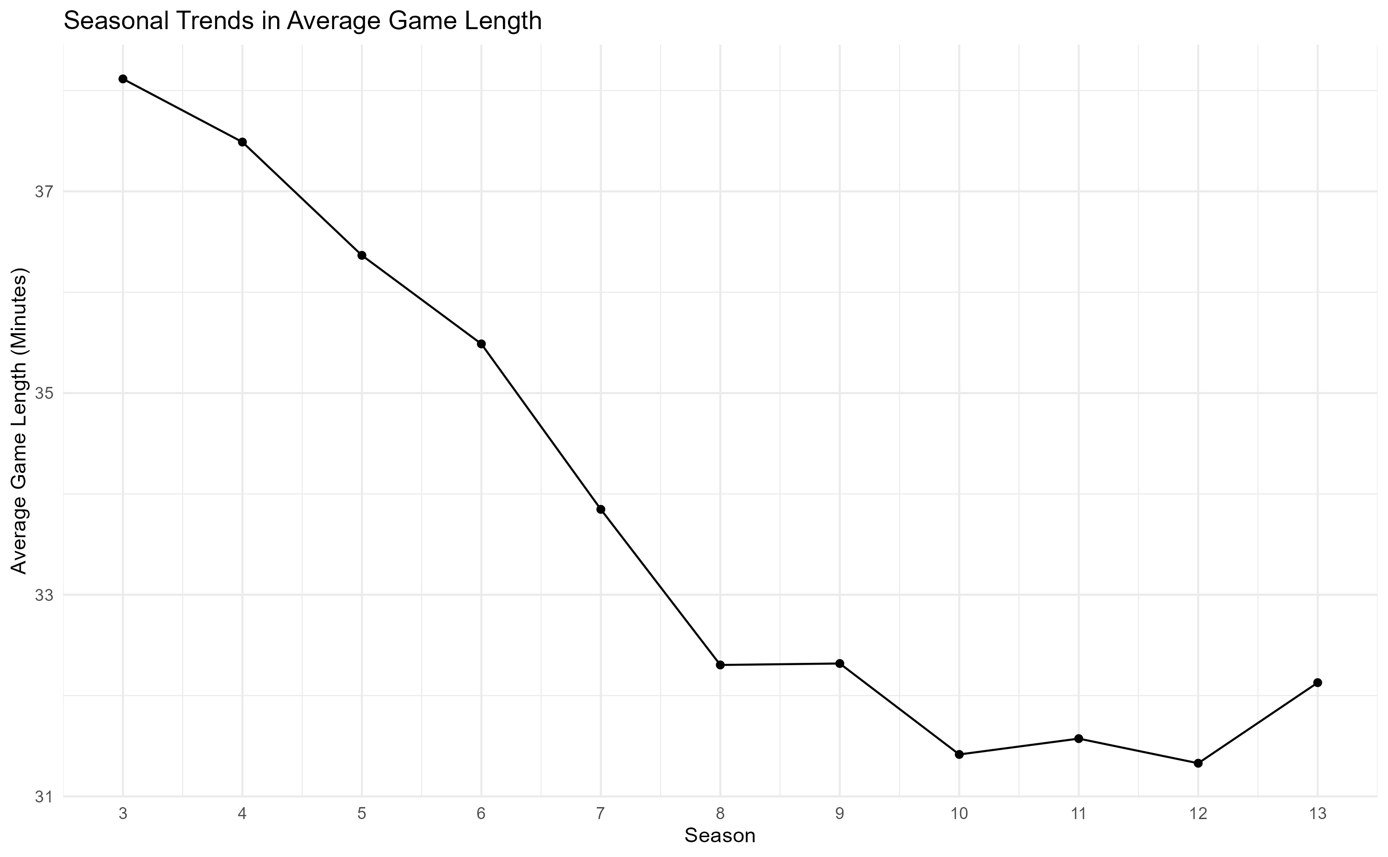
Notes:
Average game length decreased consistently, possibly indicating improvement in player or team skill, better understanding of the game or changes and shifts in the meta
Average game length is 32 minutes

Slide 17
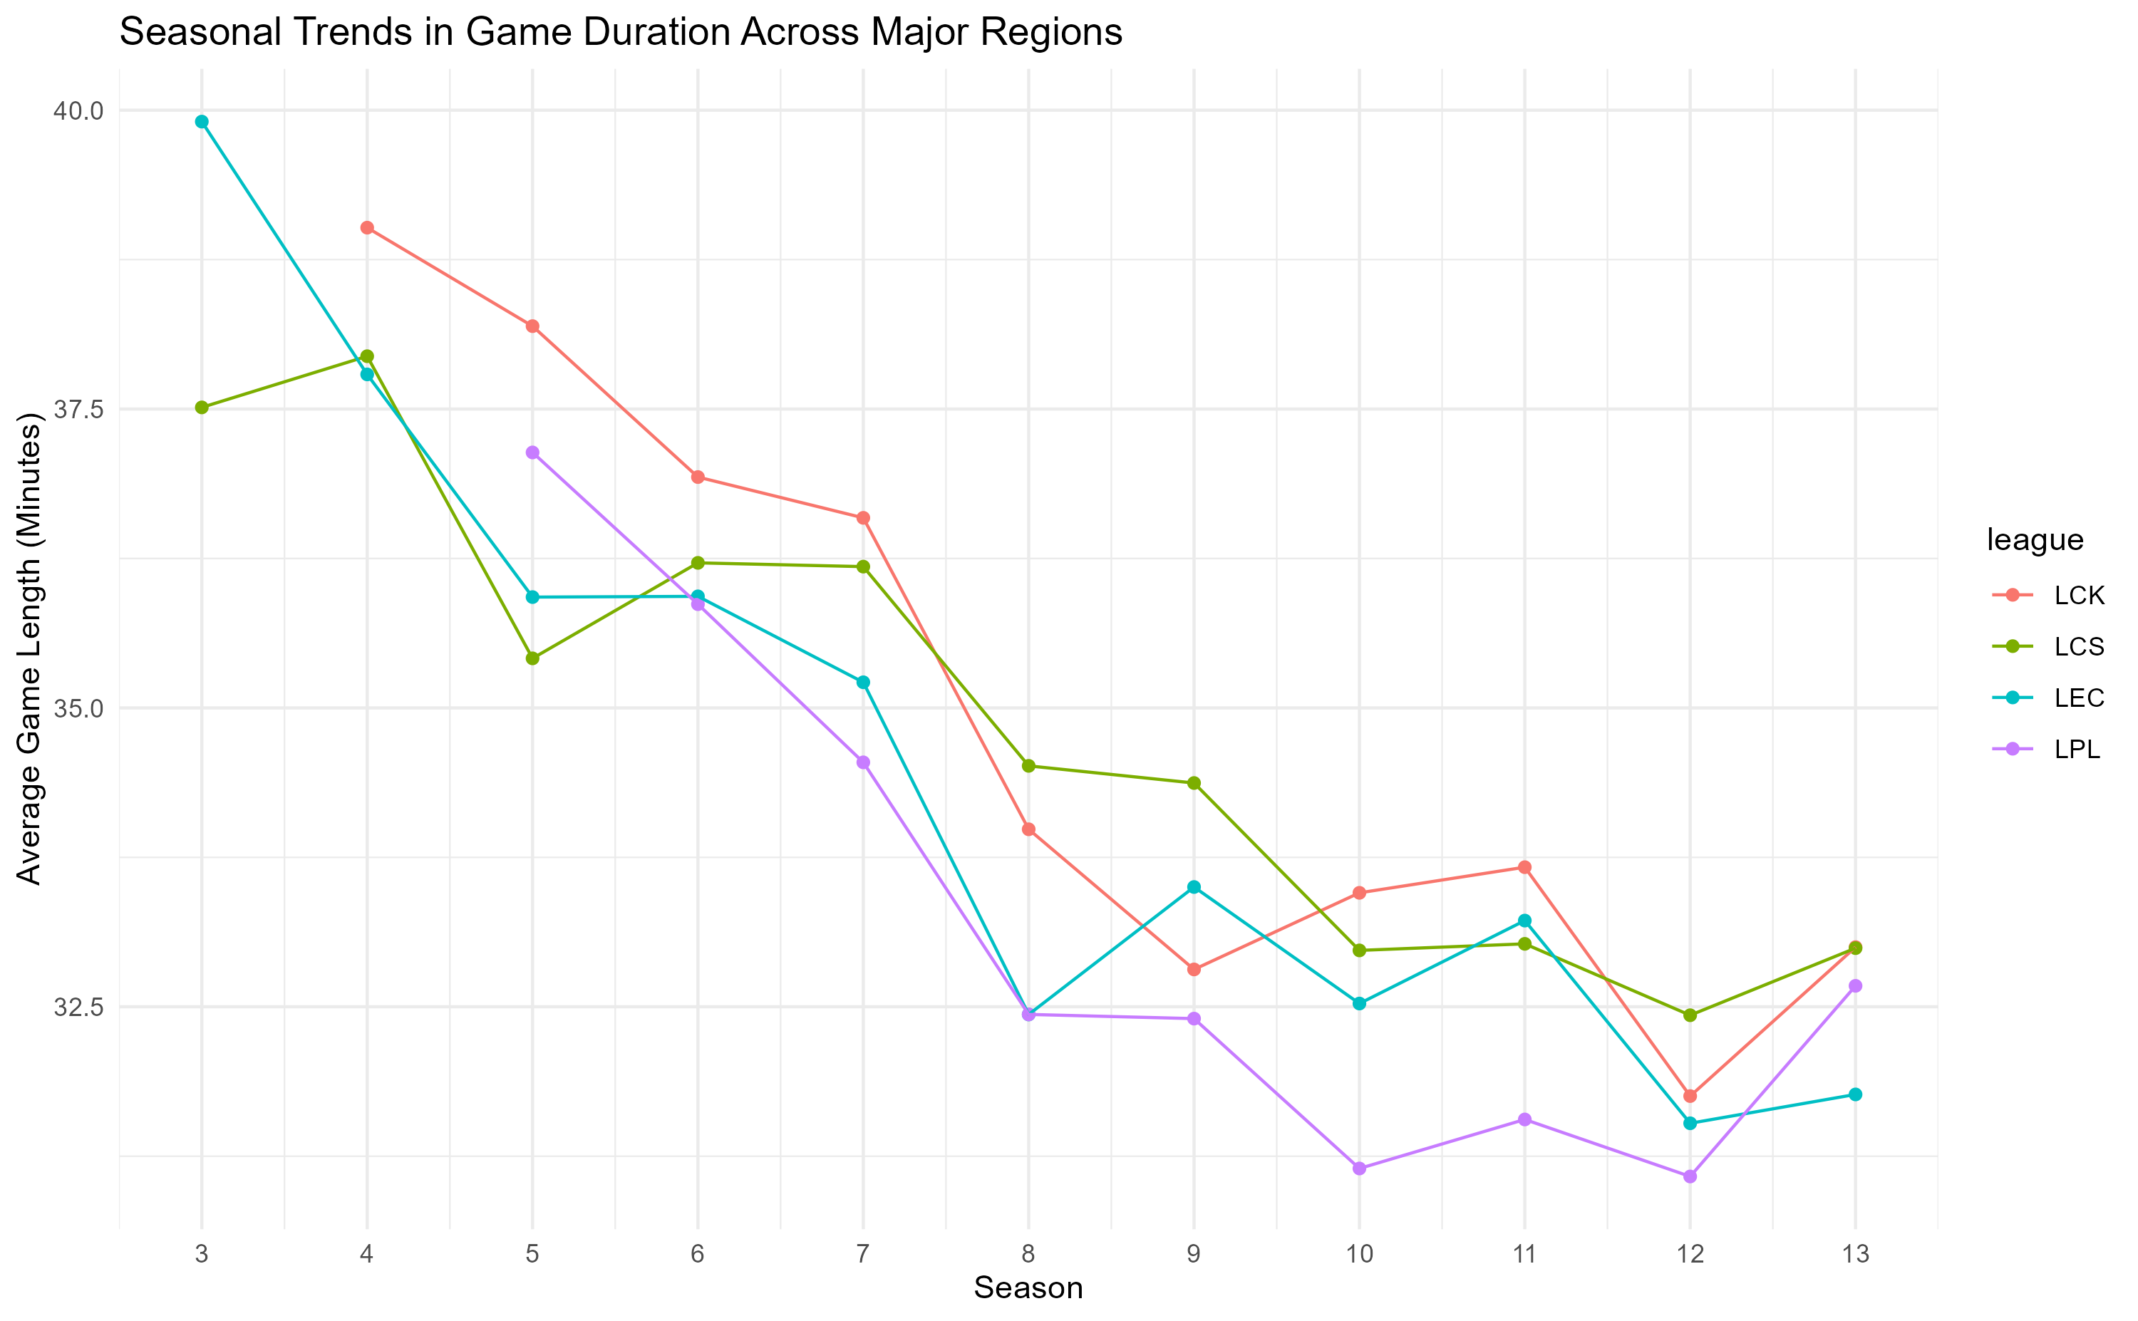
Notes:
The LPL has been having shorter games on average than other leagues since season 6, while the LCK and LCS averaged longer games on average, which could indicate differences in play styles globally

Slide 18
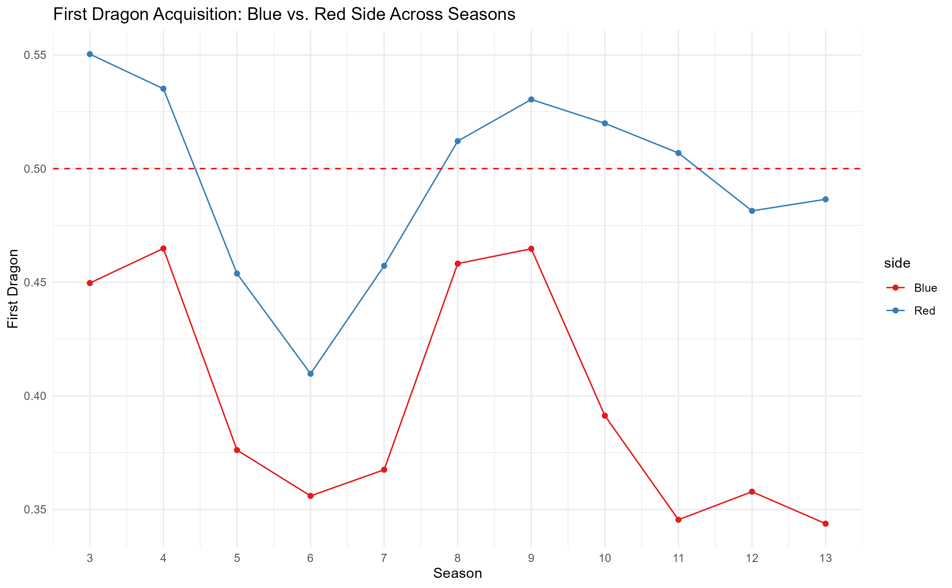
Notes:
Slight inaccuracies in data as dragons were not captured by neither teams in lower tier games
Red side tends to get first dragon, this could be due to the unique geography of the map

Slide 19
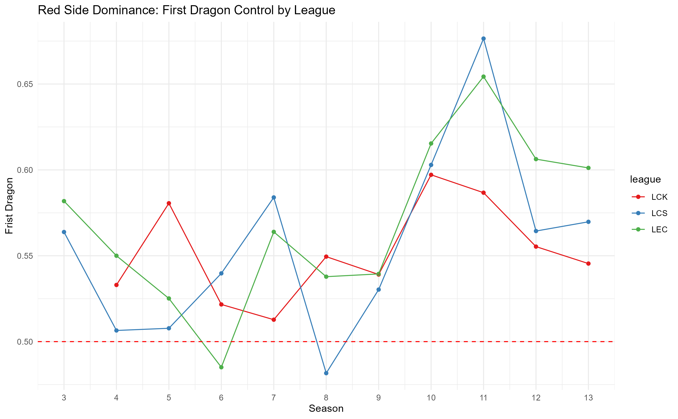
Notes:
In higher level competitions, red side has a consistently advantage in securing first dragon, the advantage is greatly realized and utilized in the later seasons (season 10 - 13)

Slide 20
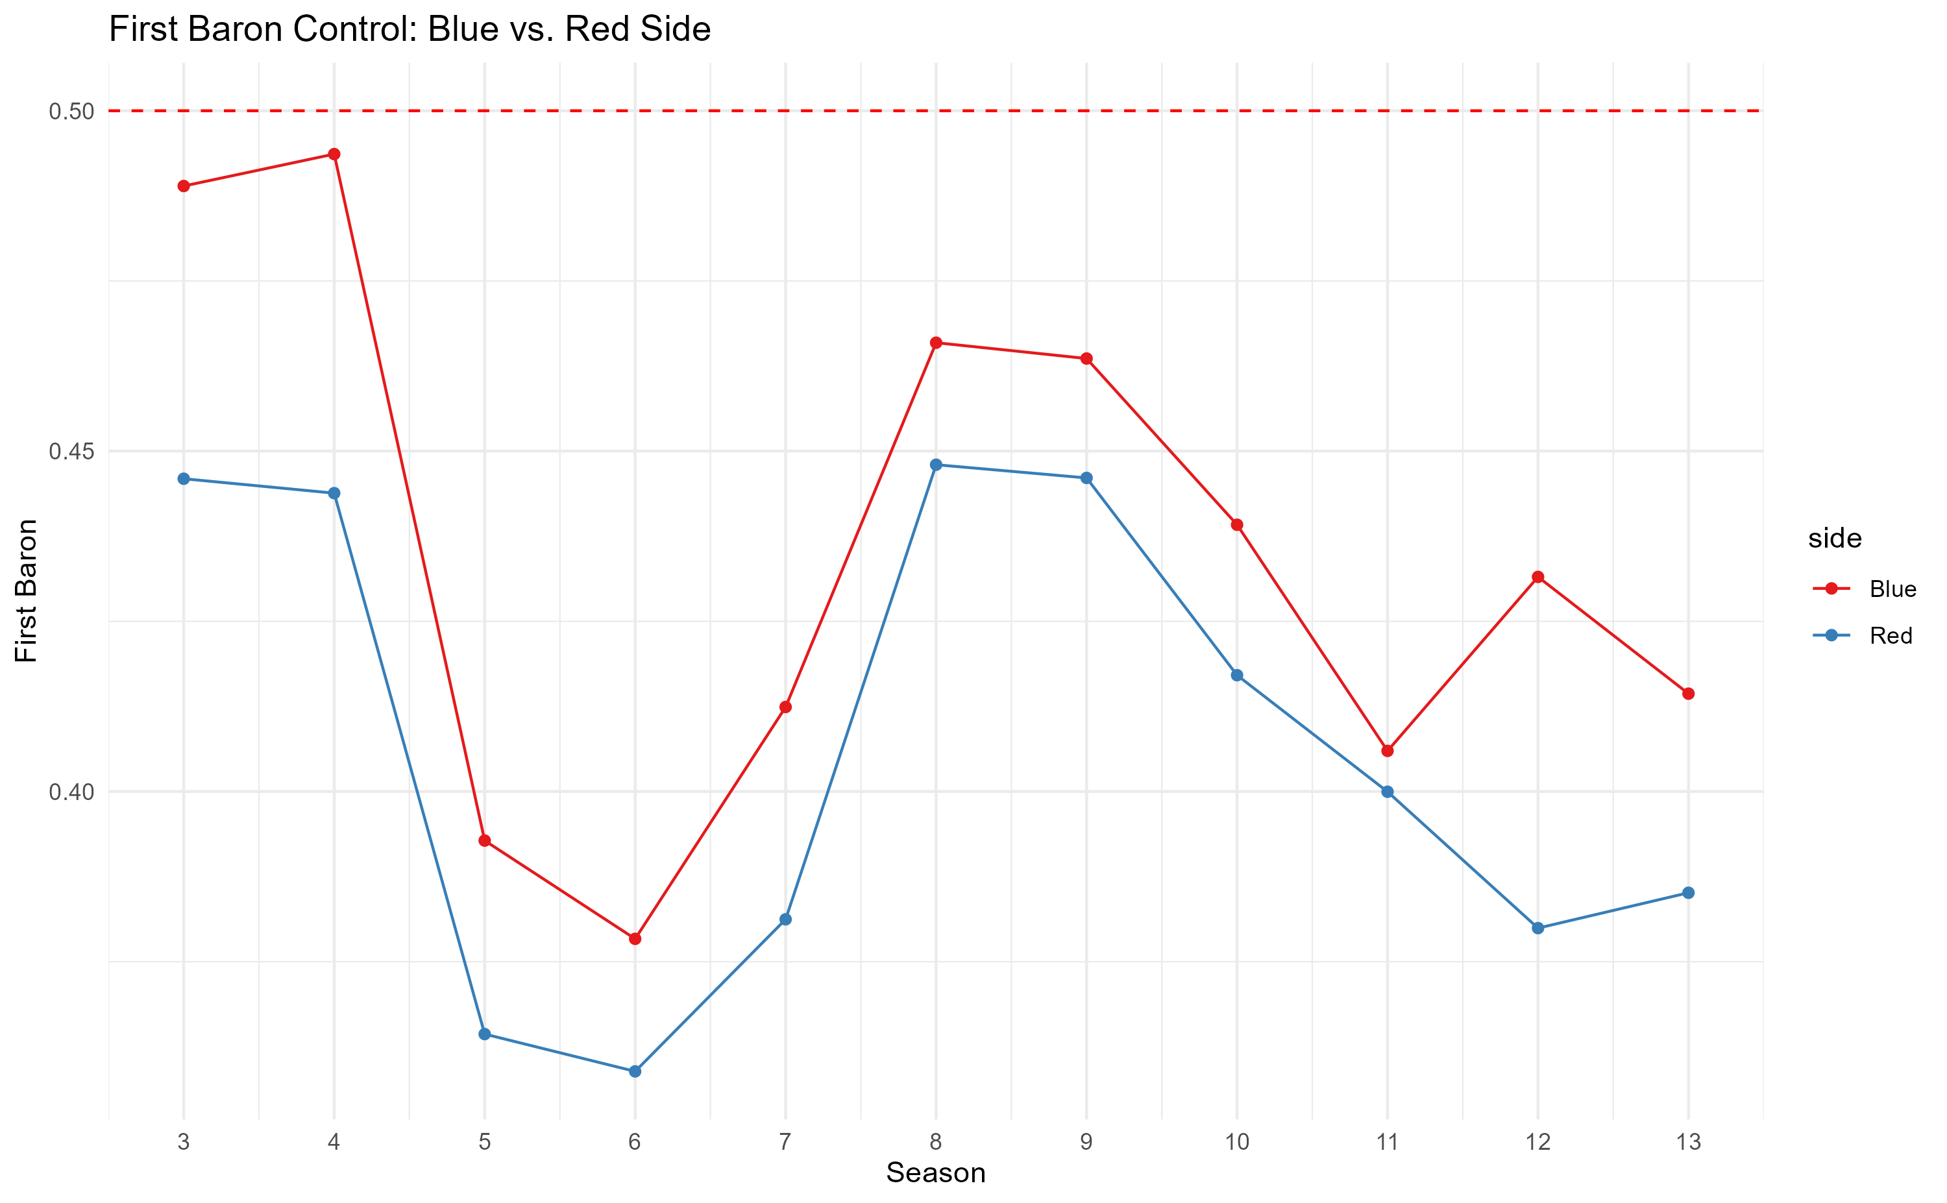
Notes:
Slight inaccuracies in data since first baron was not secured in lower tier games
Blue side tends to have an advantage in securing first baron

Slide 21
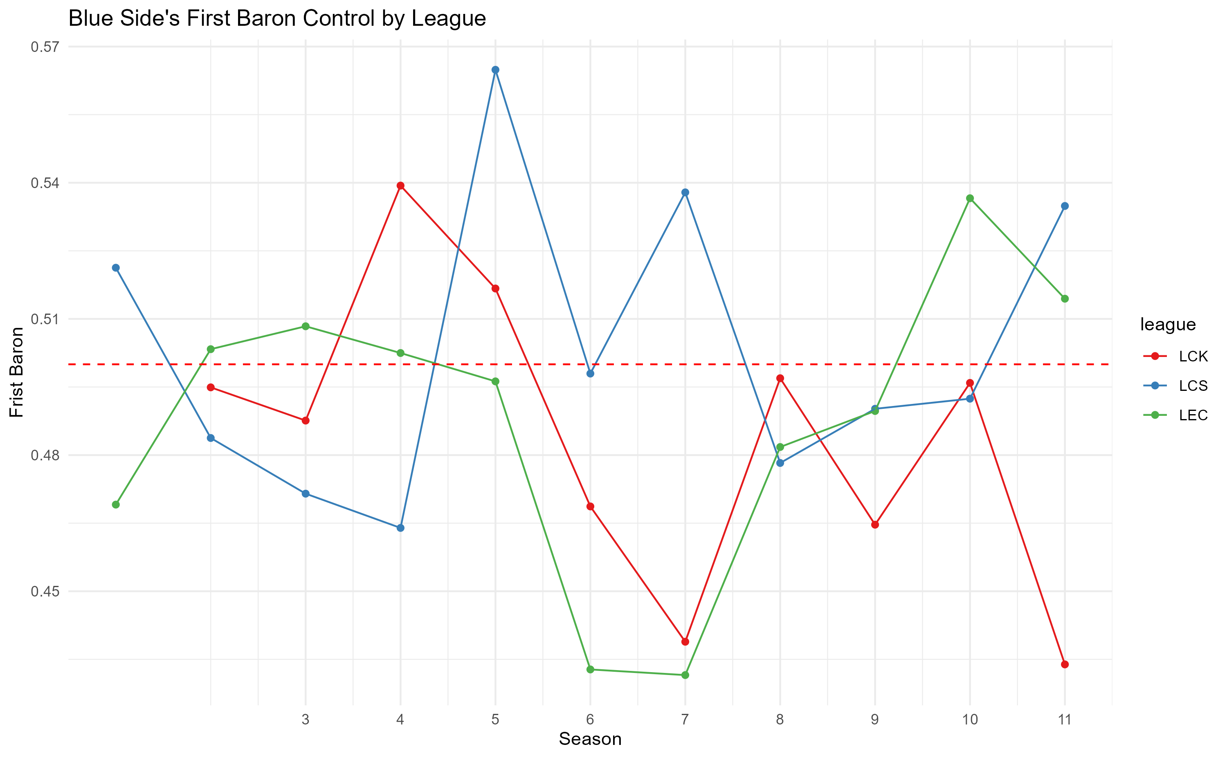
Notes:
High top tier competition, no clear advantage for blue side in securing first baron

Slide 22
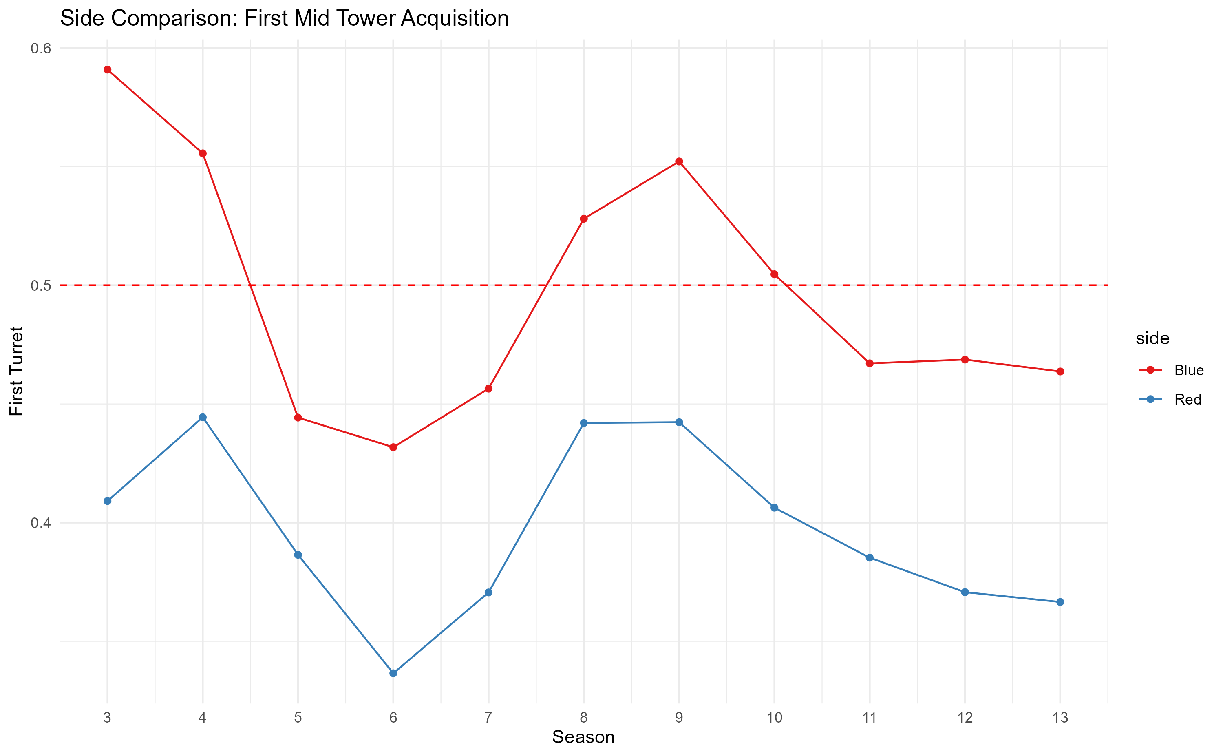
Notes:
Blue side has an advantage in securing first mid tower in all seasons

Slide 23
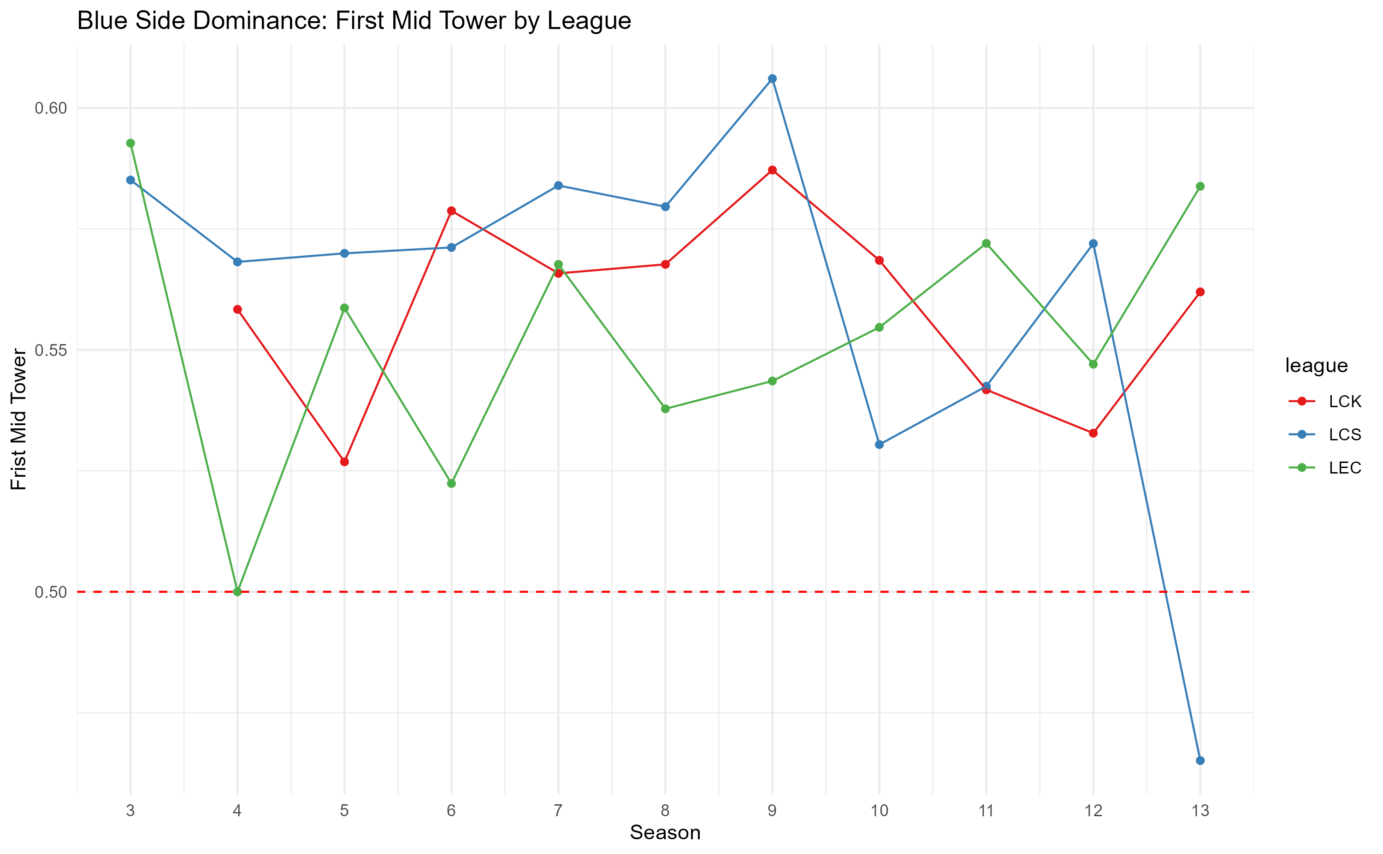
Notes:
Clear notable advantage for blue side for all leagues with LCS utilizing the advantage most often in seasons 3-9

Slide 24
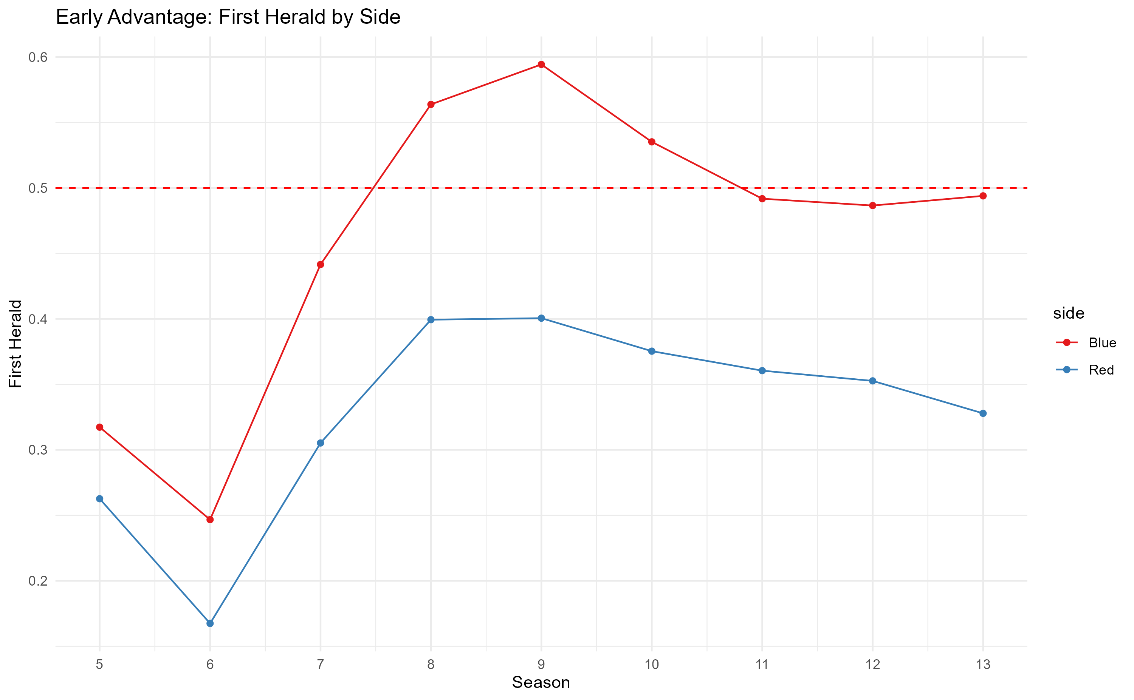
Notes:
Clear advantage for blue side when since season 5 when it comes to securing first herald
Common pattern is that top side neutral objectives are favored for blue side, whereas bot side objectives are favored for red side.

Slide 25
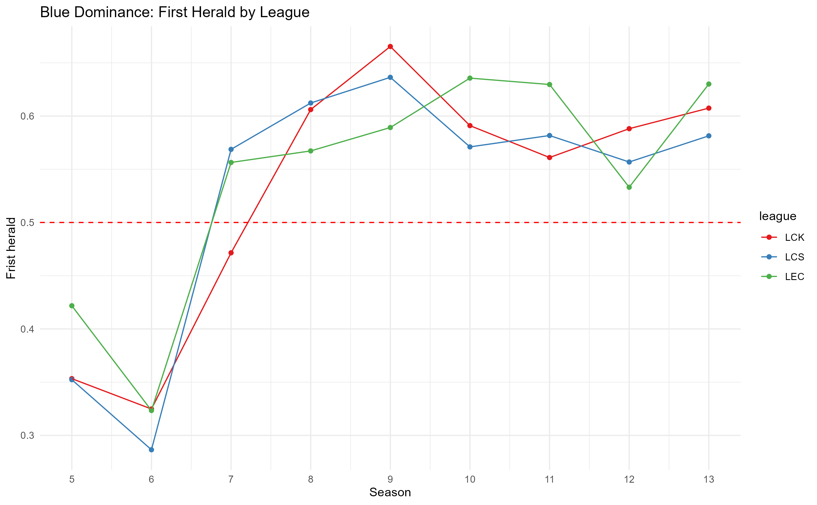
Notes:
The advantage is realized in higher levels of play in seasons 7-13

Slide 26
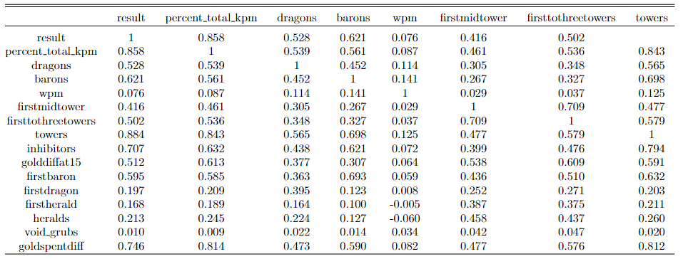
Correlation Matrix (1)
Notes:
From the correlation matrix, percent total kpm, towers and inhibitors are the key variables determining the result of a game

Slide 27
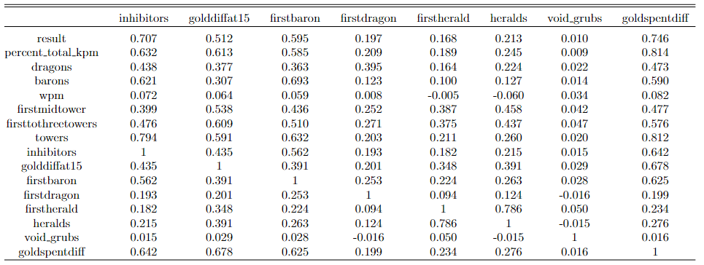
Correlation Matrix (2)
Notes:
Continuation of the correlation matrix, no significant coefficients to worry about regarding multicollinearity

Slide 28
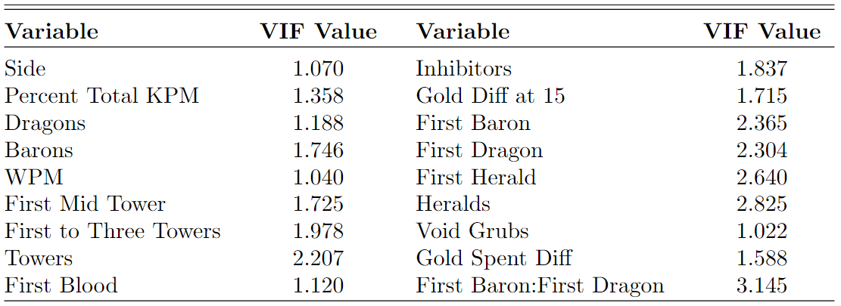
VIF
Notes:
No issues with multicollinearity can be seen from VIF values

Slide 29
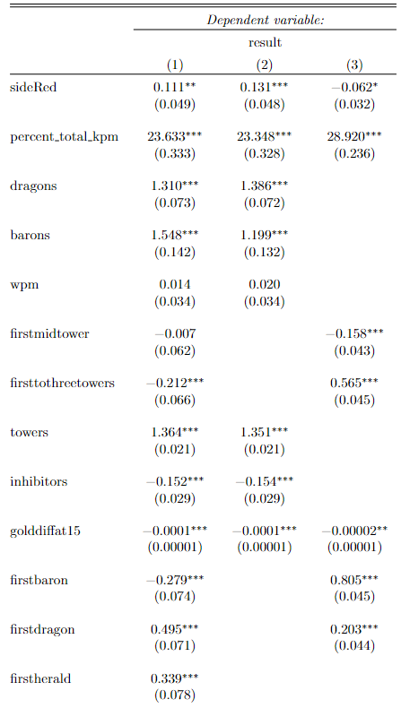
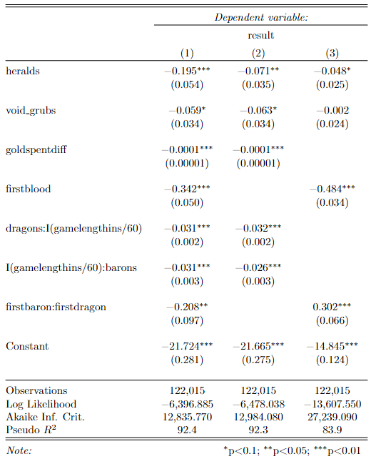
Logistic regression results
Model 1: All in game variables
Model 2: Late game variables
Model 3: Early game variables
Notes:
Model 3 performs worst with the lowest r^2 among the 3 models. Indicating that it is more difficult to predict and model the result of a game based on the first 20 minutes of the game. Model1 and 2 perform well on a similar level, however since the AIC for model1 is lower, it appears to be better
Interaction term between dragons and game length and barons with game length attempts to explain diminishing returns of the objectives based on game length

Slide 30
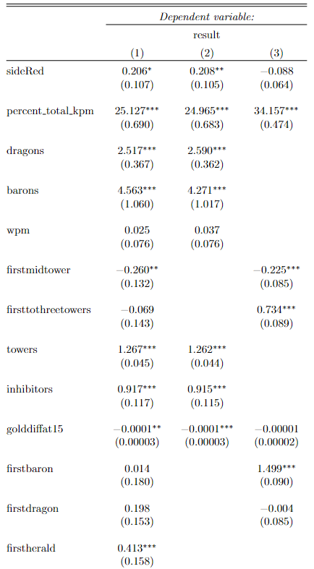
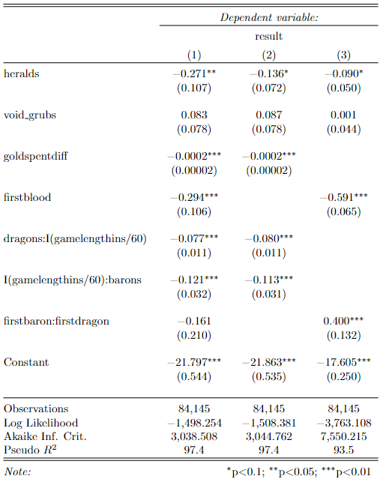
Logit models 1,2,3 on games shorter than 35 minutes
Notes:
Model 3 experienced a significant improvement in its pseudo r^2 when we looking at shorter games. Increasing from 83.9 to 93.5%. Similarly, models 1 and 2 also experienced improvements in explanatory power of the model, meaning that model 3 is simply not good enough to explain how teams win games.

Slide 31
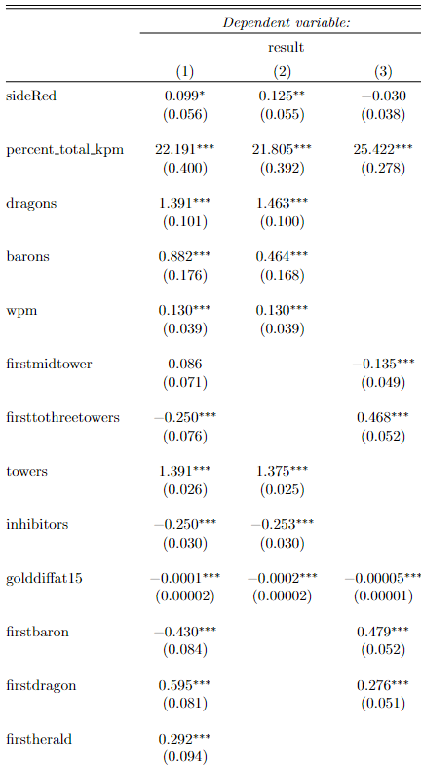
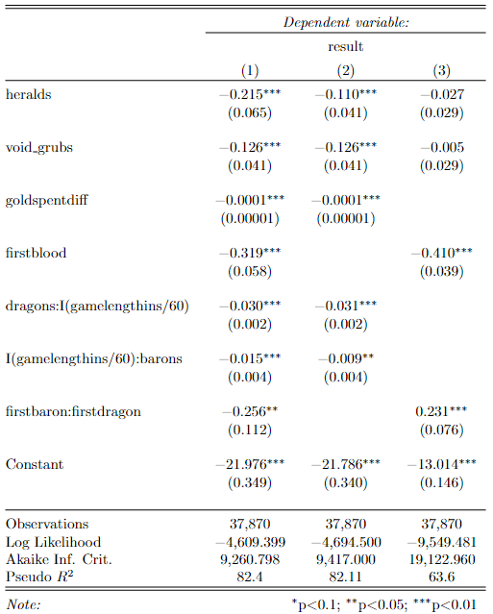
Logit models 1,2,3 on games longer than 35 minutes
Notes:
All models experienced drastic decreases in pseudo r^2, indicating that it is harder to model, explain and predict the outcome of longer games using the limited data that we have.

Slide 32
Confusion Matrix Analysis for Logistic Model 1
 | Reference |  | Classification Error
Prediction | 0 | 1
0 | 14,836 | 261 | 1.7%
1 | 317 | 15,089 | 2.1%
Accuracy: 0.9811
P-Value: <2.2 e-16
Kappa: 0.9621
Sensitivity: 0.9791
Specificity: 0.9830
Notes:
Testing the predictability of model 1 on a training set, we have low classification error for both type 1 and type 2 errors and high values for accuracy, kappa sensitivity and specificity, meaning that the logit model is really good at predicting the outcome of games using in game data

Slide 33
Confusion Matrix Analysis for Logistic Model 2
 | Reference |  | Classification Error
Prediction | 0 | 1
0 | 14,831 | 251 | 1.7%
1 | 322 | 15,099 | 2.1%
Accuracy: 0.9812
P-Value: <2.2 e-16
Kappa: 0.9624
Sensitivity: 0.9788
Specificity: 0.9836
Notes:
Testing the predictability of model 1 on a training set, we have low classification error for both type 1 and type 2 errors and high values for accuracy, kappa sensitivity and specificity, meaning that the logit model is really good at predicting the outcome of games using in game data

Slide 34
Confusion Matrix Analysis for Logistic Model 3
 | Reference |  | Classification Error
Prediction | 0 | 1
0 | 14,502 | 658 | 4.3%
1 | 651 | 14,692 | 4.2%
Accuracy: 0.9571
P-Value: <2.2 e-16
Kappa: 0.9142
Sensitivity: 0.9570
Specificity: 0.9571
Notes:
Testing the predictability of model 1 on a training set, we have low classification error for both type 1 and type 2 errors and high values for accuracy, kappa sensitivity and specificity, meaning that the logit model is really good at predicting the outcome of games using in game data

Slide 35
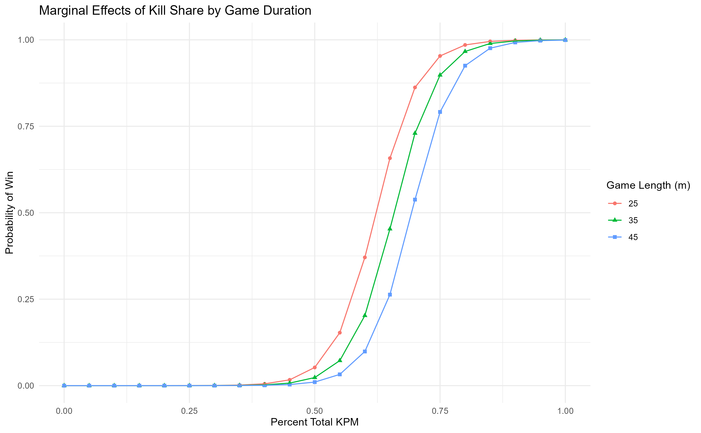
Notes:
The shorter the game, the more important kill share (percent total kpm) is

Slide 36
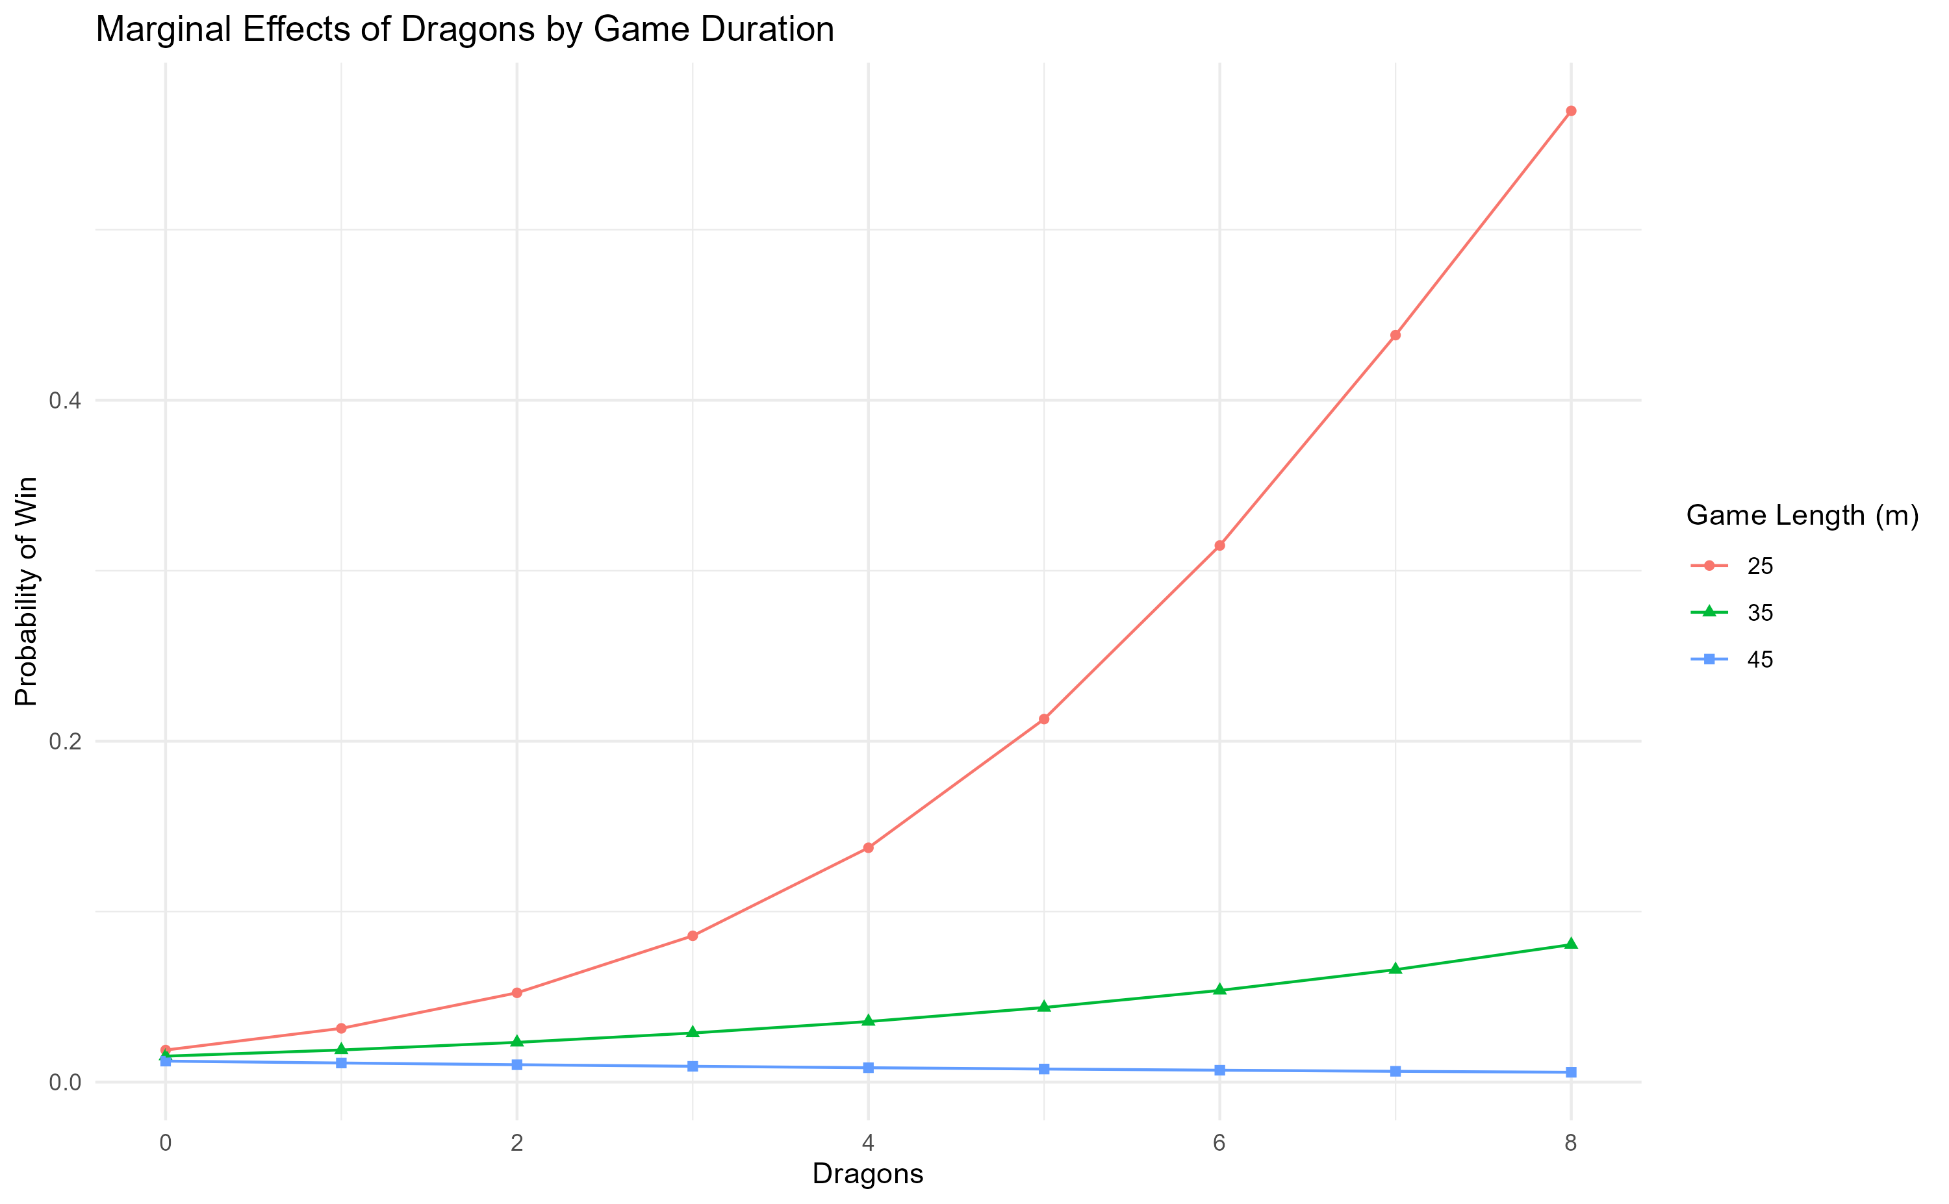
Notes:
The shorter the game the more important dragons are, but if a game is beyond 45 minutes, it plays little to no role in determining the outcome

Slide 37
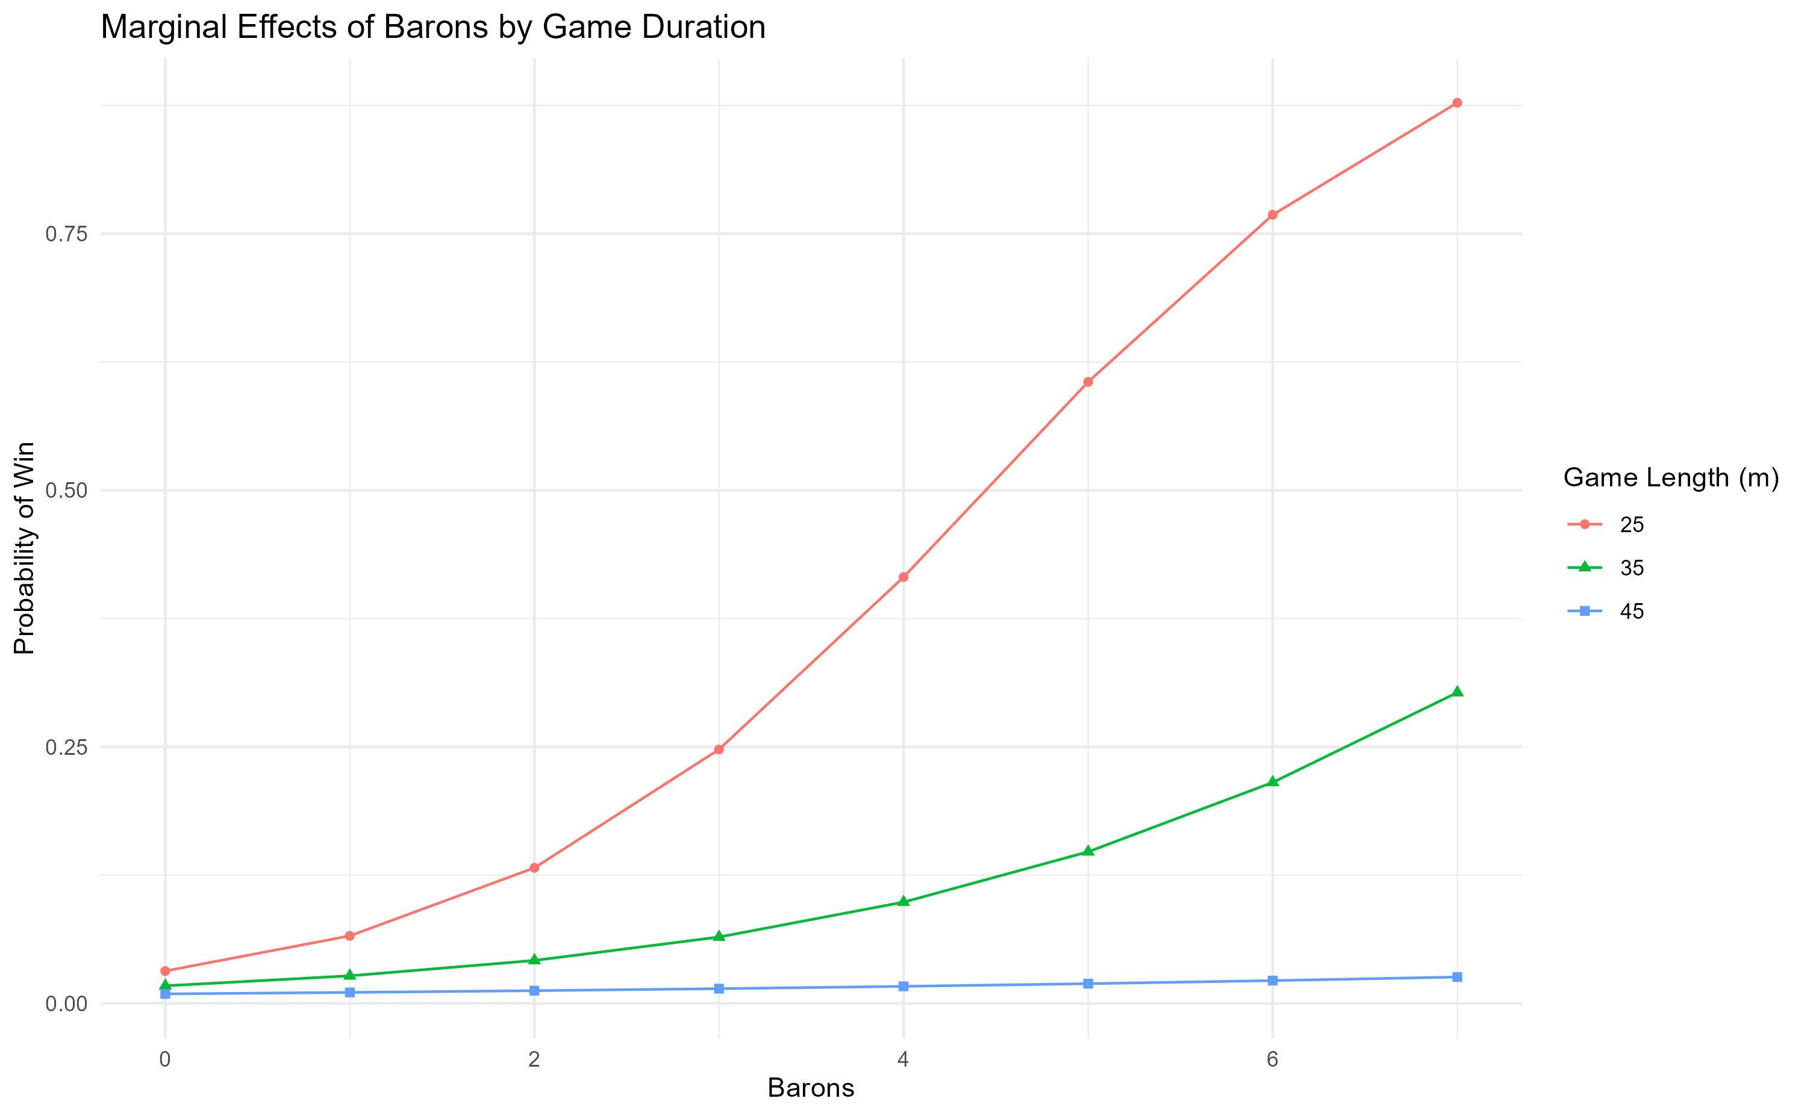
Notes:
Shorter the game, more important barons are, but if a game is beyond 45 minutes, it plays little to no role in determining the outcome

Slide 38
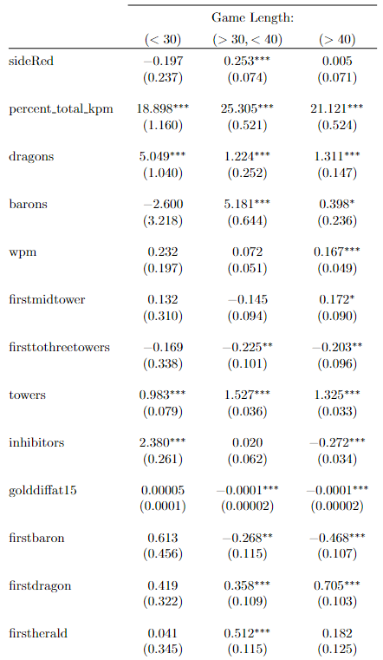
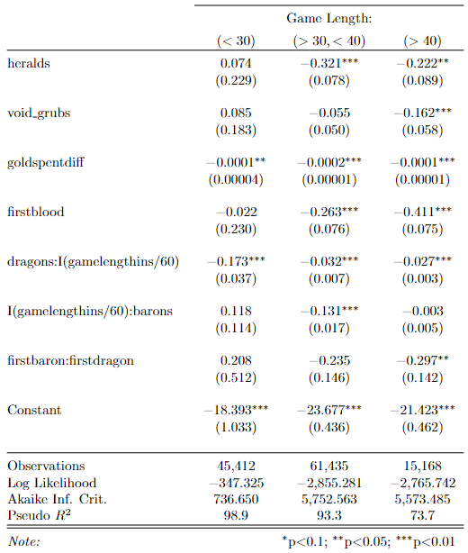
Logit model 1 on a range of game lengths
Notes:
Comparing model 1s performance across games of varying game lengths, as expected, its performance decreases as game time increases.
Looking at the coefficients, we can see that kills matter less for games that are shorter than 30 minutes, and it increases in importance for games longer than 30 minutes. However, up to a certain point, the importance drops back down. A possible explanation for this is that the advantages gained from kills are reduced as the game goes beyond 40 minutes since everyone is already at full build, meaning that bonus gold and experience no longer offers additional benefits.
a lot of the advantages from sides dissipates after we incorporate other variables, for a game of average game length, it is red side with an advantage, other than that there is no statistical significance on side selection
Overall, total number of objectives secured is less important as the games exceeds beyond the 40 minute mark
Towers are important regardless of the length of the game
Inhibitors are only important if teams intend to end games before the 30 minute mark, beyond that point, it matters less
Early gold leads and over all gold leads appear to play a very minor if not negative role, which means that players should not be focusing too much on advantages in gold
What is surprising is that firstblood doesn’t help a team close out a game before 30 minutes, and it has a negative impact on the game result. This could be due to an external variable that is not being taken account of which is team composition where teams have a natural advantage in either early stages of the game or later stages of the game.

Slide 39
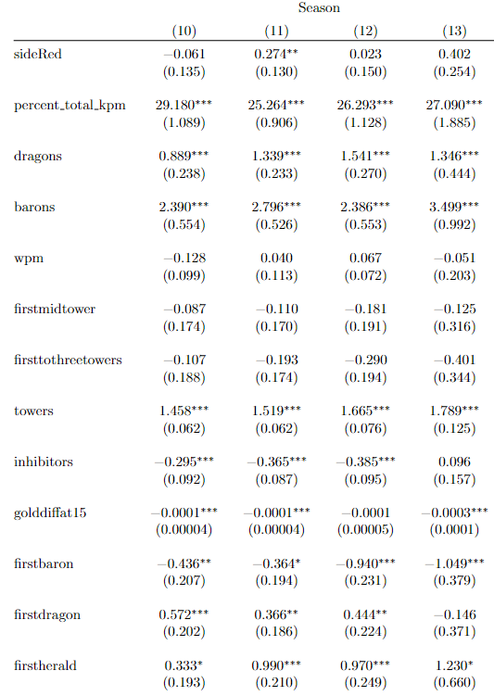
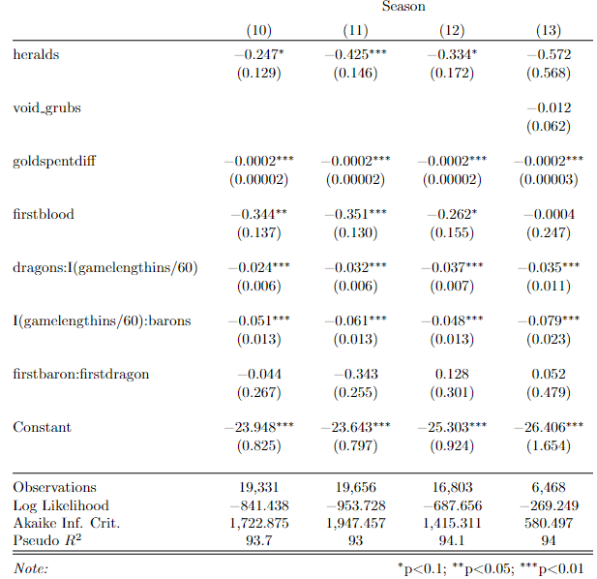
Logit model 1 on seasons 10-13
Notes:
Good model performance from seasons 10 – 13
Side selection didn’t matter, apart from red side having a slight advantage in season 11
Importance of kill share is around the same over these 4 seasons, being the most important aspect in achieving wins
Dragons have little influence on the result in season 10, but probably due to changes made to the game, the importance increased from season 11 onwards
Importance of barons fluctuated over the 4 seasons, with a significant increase from season 12 to 13,
Importance of towers remained around the same
First dragon is more important that first baron, however, the total number of barons secured is more important than dragons

Slide 40
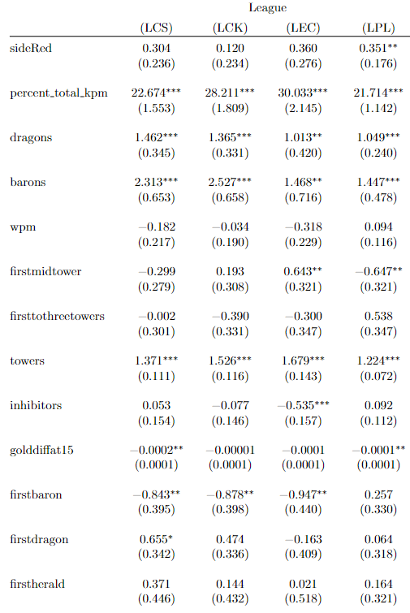
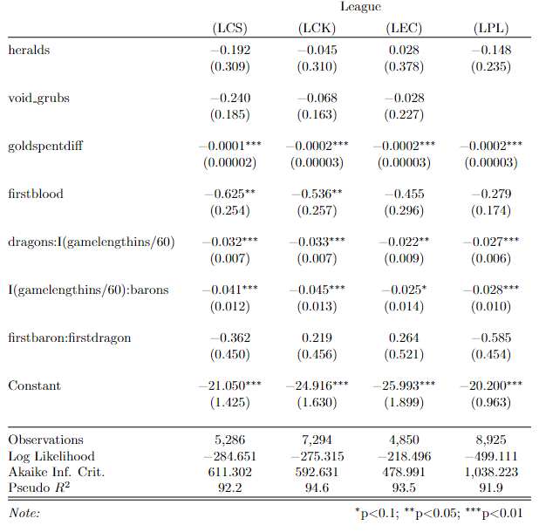
Logit model 1 by major region
Notes:
Red side has a slight advantage in the LPL
Kills are most important in LCK and LEC
Dragons are most important in LCs and LCK, slightly less important in LEC and LPL
Barons are utilized to more effectively in LCS and LCK where as it plays a smaller role in LEC and LPL
Overall, early game leads and advantages play little to no role in positively affecting the outcome of the game

Slide 41
Variables
Draft (35):
Champions by side and role (10)
Role specific matchups, and interaction terms signifying lane jungle dynamics (11)
Champion picks (10)
Champion bans (10)
Player (12):
Player by side and role (10)
Teams (2)
In-game (17):
Metrics for gold (3)
Metrics for experience (2)
Objectives (10)
Metrics for kills (2)

Slide 42
Random forest 1 with draft, player and in-game variables
 | Reference |  | Classification Error
Prediction | 0 | 1
0 | 14,638 | 78 | 0.5%
1 | 626 | 15,161 | 4.0%
Accuracy: 0.9771
P-Value: <2.2 e-16
Kappa: 0.9541
Sensitivity: 0.9594
Specificity: 0.9947
Notes:
Slightly lower accuracy than logit model 1, higher type 1 error, but improvements in type 2 error, the model is better at predicting losses

Slide 43
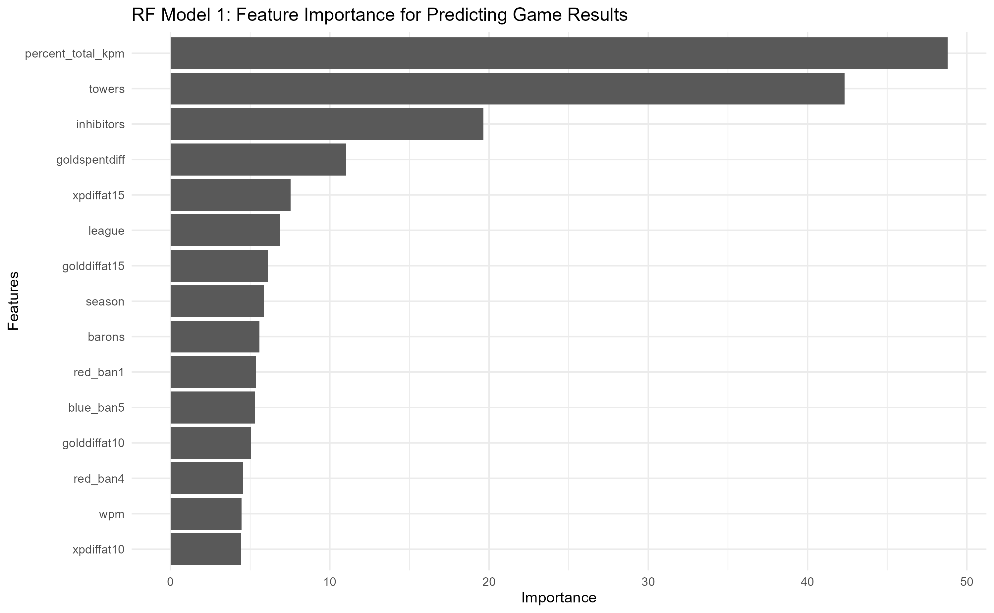
Notes:
Kill share is the most important feature to look at when predicting game result. Followed by towers and inhibitors.
What is surprising is that barons is a lot less important

Slide 44
Random forest 2 with in-game variables
 | Reference |  | Classification Error
Prediction | 0 | 1
0 | 14,914 | 218 | 1.4%
1 | 350 | 15,021 | 2.3%
Accuracy: 0.9814
P-Value: <2.2 e-16
Kappa: 0.9628
Sensitivity: 0.9771
Specificity: 0.9857
Notes:
Accuracy improves when using in game data only, meaning that player skill and draft matters less than the actual events that occur in game

Slide 45
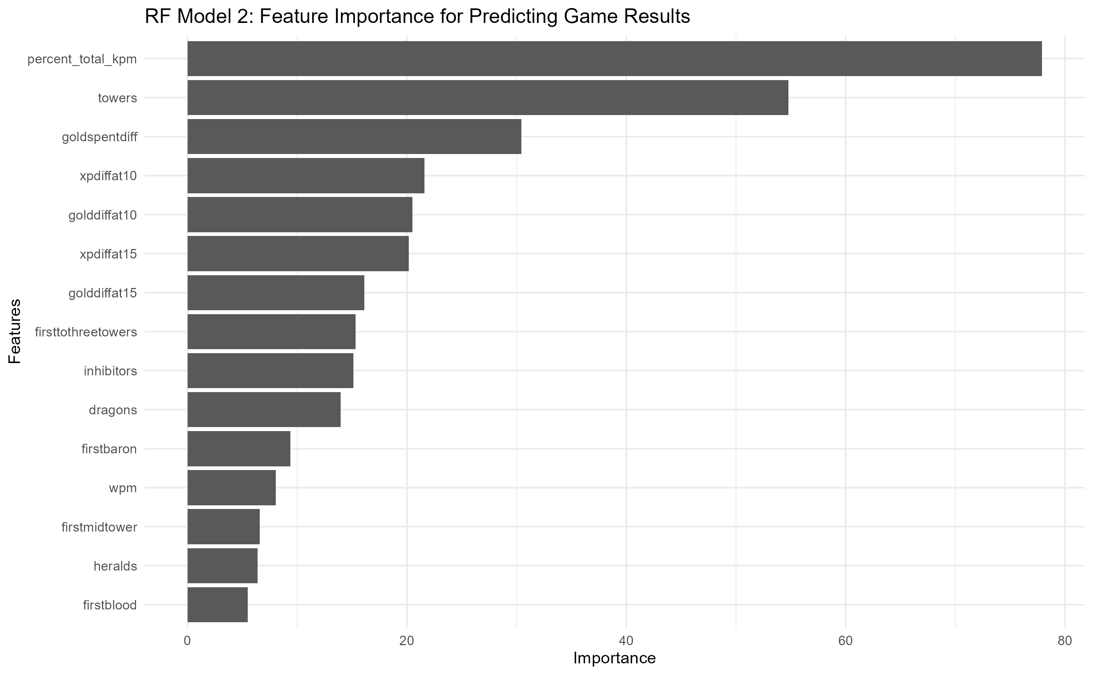
Notes:
Like the first rf model, kill share is the most important feature followed by towers, however, the importance of inhibitors decreased, making difference in gold spent at the end of the game a more important feature in predicting the game results

Slide 46
Random forest 3 with draft and player variables
 | Reference |  | Classification Error
Prediction | Blue | Red
Blue | 5,639 | 3,652 | 39.3%
Red | 2,477 | 3,483 | 41.6%
Accuracy: 0.5981
P-Value: <2.2 e-16
Kappa: 0.1848
Sensitivity: 0.6948
Specificity: 0.4882

Slide 47
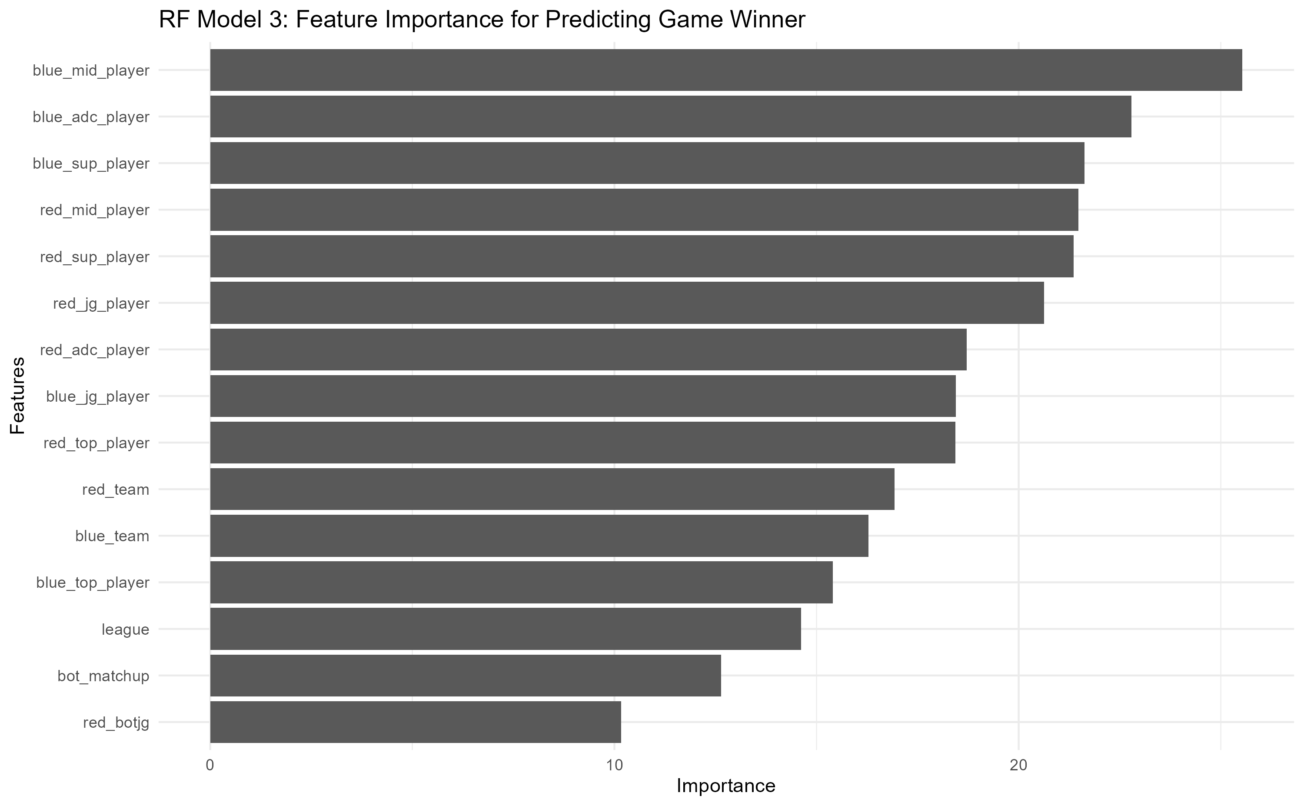

Slide 48
Xgboost Model 1 with draft and player variables
 | Reference |  | Classification Error
Prediction | Blue | Red
Blue | 5,463 | 3,250 | 37.3%
Red | 2,760 | 3,778 | 42.2%
Accuracy: 0.6059
P-Value: <2.02e-16
Kappa: 0.2029
Sensitivity: 6644
Specificity: 0.5376
Notes:
Drastically lower accuracy with low kappa and high classification error, indicating that it is simply using draft and player information is not enough to predict the outcome of games to a high level of precision

Slide 49
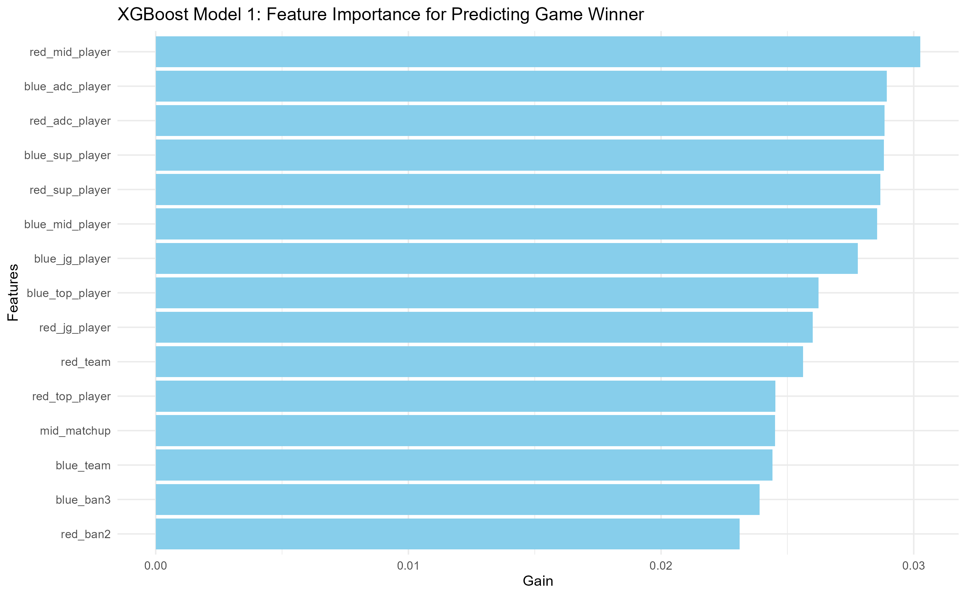
Notes:
Players and team information are more important than draft, which could indicate that player skill plays a bigger role than the actual draft. With mid laners and bot laners being the relatively more important roles

Slide 50
Random forest 4 with draft variables
 | Reference |  | Classification Error
Prediction | Blue | Red
Blue | 5,627 | 4,768 | 45.9%
Red | 2,489 | 2,367 | 51.3%
Accuracy: 0.5242
P-Value: <0.9766
Kappa: 0.0256
Sensitivity: 0.6933
Specificity: 0.3317

Slide 51
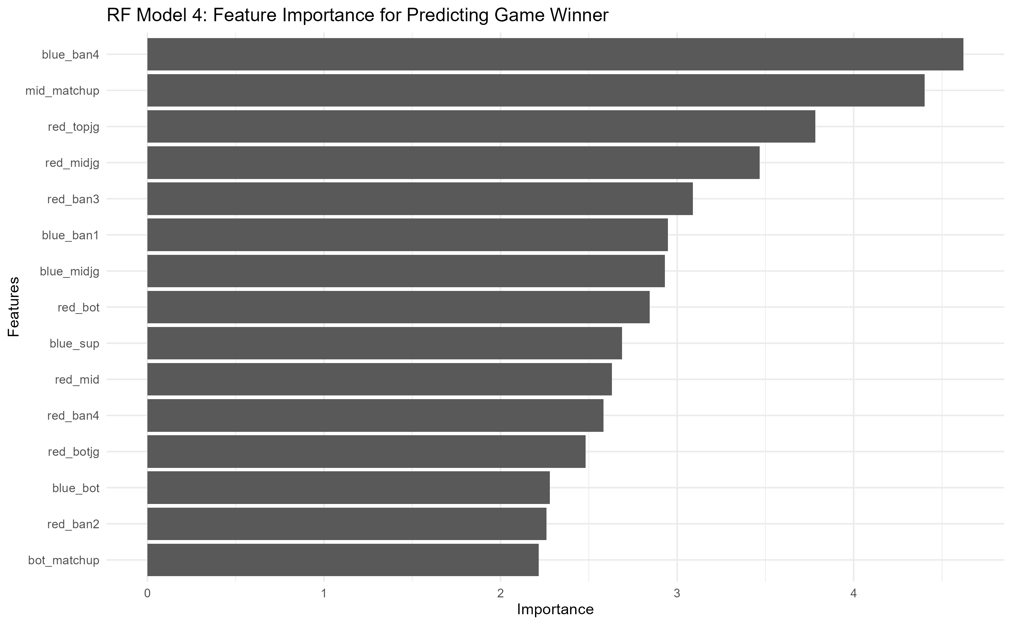

Slide 52
Xgboost Model 2 with draft variables
 | Reference |  | Classification Error
Prediction | Blue | Red
Blue | 5,050 | 4,041 | 44.5%
Red | 3,173 | 2,987 | 51.5%
Accuracy: 0.527
P-Value: <0.9988
Kappa: 0.0395
Sensitivity: 0.6141
Specificity: 0.4250
Notes:
Predicting the winner using only draft data is not accurate, this could indicate that at the current level of drafting in professional play, there is no obvious “draft gaps” which is a term commonly used to imply a team's inability to select and ban appropriate champions.

Slide 53
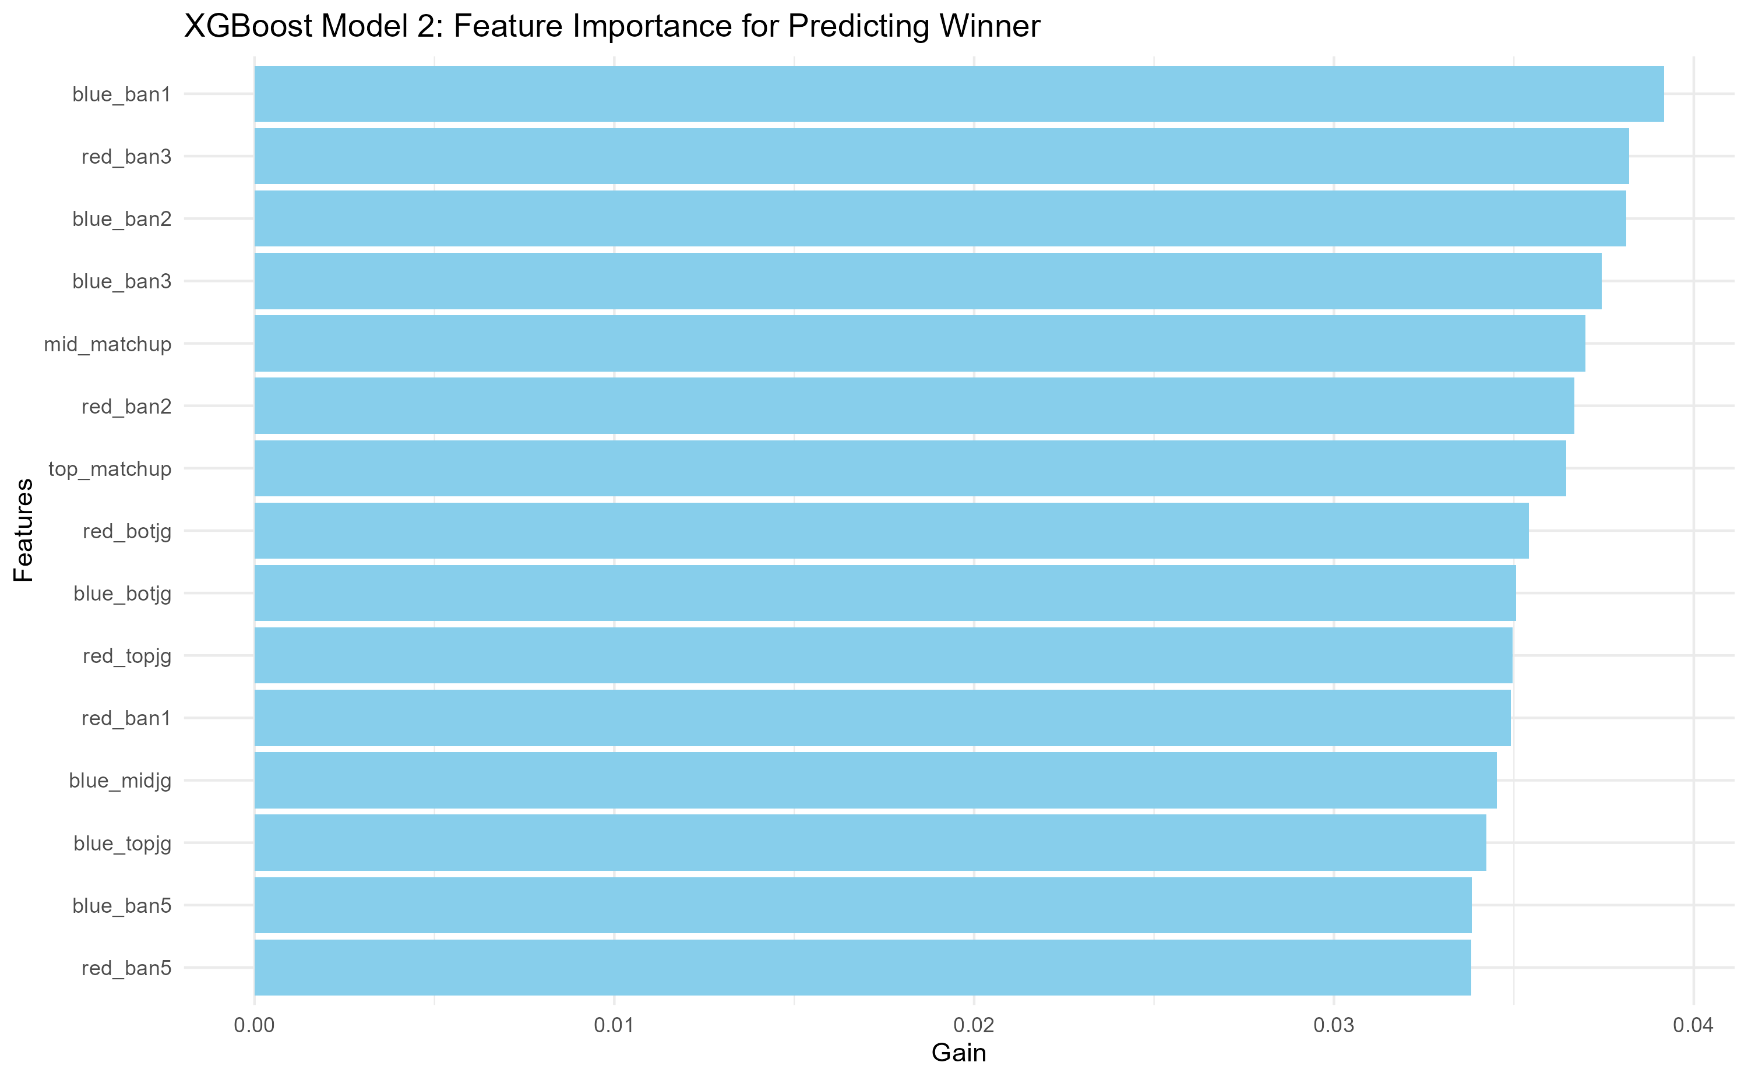
Notes:
Bans are more important than picks, with solo lane matchups being the most important followed by the bot jg dynamic, indicating a top side meta. Individual picks play a less significant role when considering of synergies between laners and junglers.

Slide 54
Xgboost Model 3 with draft variables on Season 12
 | Reference |  | Classification Error
Prediction | Blue | Red
Blue | 709 | 563 | 44.3%
Red | 395 | 430 | 52.1%
Accuracy: 0.5432
P-Value: <0.06559
Kappa: 0.0759
Sensitivity: 0.6422
Specificity: 0.433
Notes:
Since the meta for draft changes often, here is a model on trained and tested on season 12 alone. It still performs poorly, possibly due to meta shifts within a season and or draft simply having less importance than player skill, and in game performance

Slide 55
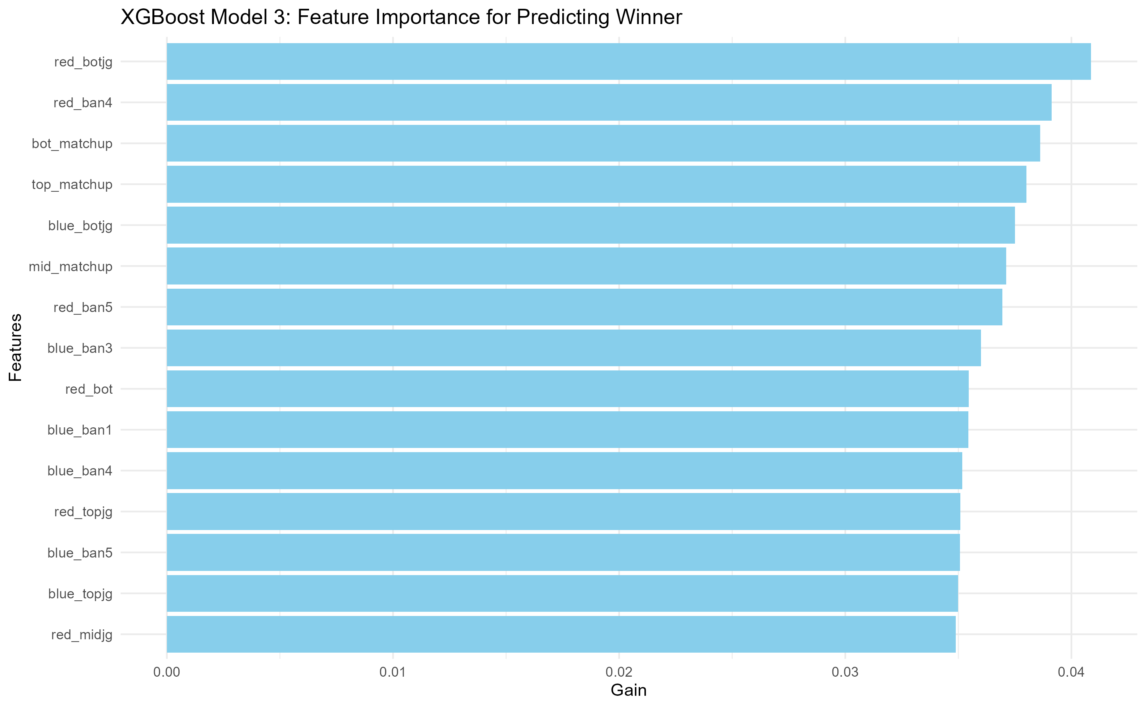
Notes:
Looking at feature importance, in season 12, bot jg dynamic and the specific bot and top matchup played a more significant role than other roles. Indicating a bot side meta

Slide 56
Possible Extensions
Explore factors contributing to a team's ability to secure objectives.
Investigate the impact of external factors (patch updates, meta shifts, early/ late game compositions) on objective control.
The models are not perfect. Therefore, continuous refinement of models and methodologies is essential to adapt to the dynamic landscape of professional esports.

